Slide 1

Department of information technology
Shri Vaishnav Vidyapeeth Vishwavidyalaya
Shri Vaishnav Institute of Information Technology
class: IT - B
Subject: Minor Project
Subject Code: [BTCS606]
Submitted to:-
Prof. Gaurav Vinchurkar
Submitted By:-
Sachin Kumar Kodli [19100BTIT06607]
Sheikh Junaid[19100BTIT06611]
Shristi Sisodiya [19100BTIT06615]
Yuvraj Nagar[19100BTIT06642]

Slide 2

Topic: Online Voting System

Slide 3

content
Introduction
Problem With Manual Voting
Objective
Security Issues
Requirements for voter
System Domain

Slide 4
Introduction
An online voting system is a software plateform that allows groups to secureley conducts votes and election. High quality online voting system balance Bollot security,accessibility,and the overall requirements of an organization’s voting event.

Slide 5
at their core, online voting system protect the integrityof your vote by preventing voters from being able to vote multiple times as a digital platform, they eliminate the need to gather in-person,cast,votes using papers,or buy any other means(eg Email,insecure service software)
Introduction
You may hear an online voting system being referred to as an online election system, an online e voting system, or electronic voting. These all make reference to the same thing: a secure voting tool that allows your group to collect input from your group and closely scrutinize the results in real time.

Slide 6
Problem with manual voting system
The problems of the existing manual system of voting include among others the following:
1. Expensive and time consuming
2. Too much paper work
3. Errors during data entry
4. Loss of registration forms
5. Short time provided to view the voter register

Slide 7
objectives
The specific objectives of the project include: -
Reviewing the existing/current voting process.
Coming up with an automated voting system.
Implementing a an automated online voting system.
Validating the system to ensure that only legible voters are allowed to vote.

Slide 8

security issue
Foreign Expreience revealed that they are often confronted by security issues. While the online voting system is running. The origin of the security issues was due to know to only outsider (such as voters and attackers) but also insider(such as system develoer and administrator),even just because the inheritance. Of some objecting the source code are unstable.these errors cause the voting system to crash. The proposed solution were cores ponding outend to hold back these attackers.

Slide 9
sOlution
For ex: to avoid hacker making incursion into the voting system via network,we can design our system to transmit data without network.
Another ex: is to limit voter to input particular data so,taht we can prevent the command iniection from running.

Slide 10
Requirements For Voter
Registration is done by the voter first.
for Registration voter has to provide their phone no. Or enrollement.
An unique otp is given to the voter for confirmation.otp is provided by the database.
Voter has to create a login id and password.
In the database information of every database is stored.
Database shows the information of every user.

Slide 11
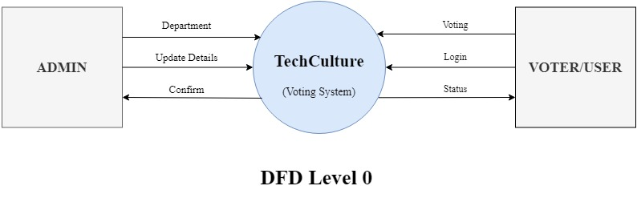
Data Flow Diagram (Level - 0)

Slide 12
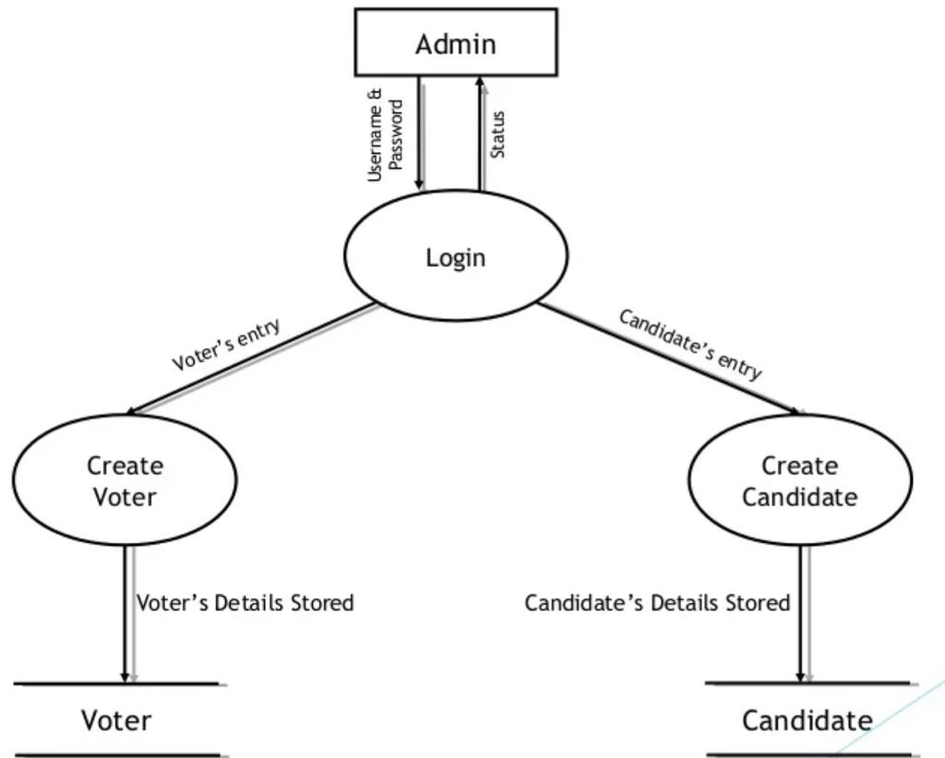
Data Flow Diagram (Level - 1) ADMIN

Slide 13
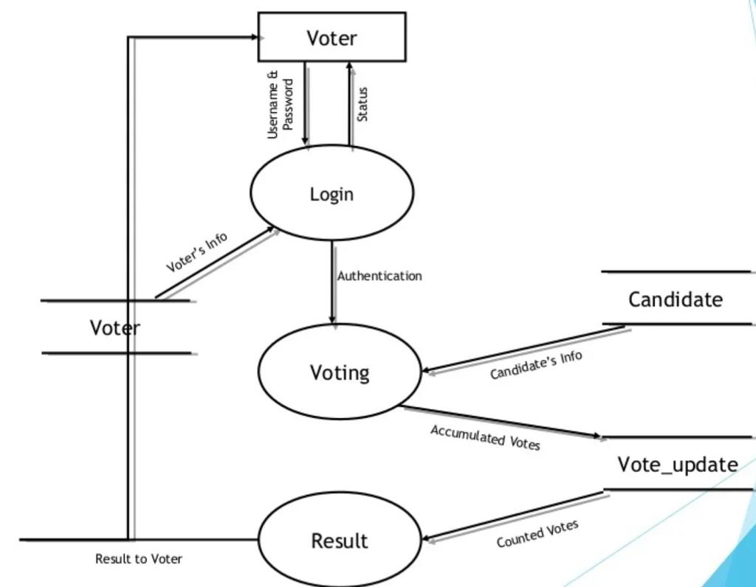
Data Flow Diagram (Level - 1) Voter

Slide 14

System Domain
Language:- PHP, HTML, bootstrap, css, sql
DataBase:- SQL, Google Firebase
Backend:- PHP
Frontend:- HTML,CSS,PHP, Bootstrap

Slide 15
THANK YOU

